Slide 1
Chapter No:2
Number System, Operation and Codes

Slide 2
CHAPTER OUTLINE
Decimal Numbers
Binary Numbers
Decimal-to-Binary Conversion
Binary Arithmetic
Complements of Binary Numbers
Signed Numbers
Arithmetic Operations with Signed Numbers
Hexadecimal Numbers
Octal Numbers
Binary Coded Decimal (BCD)
Digital Codes
Error Codes

Slide 3
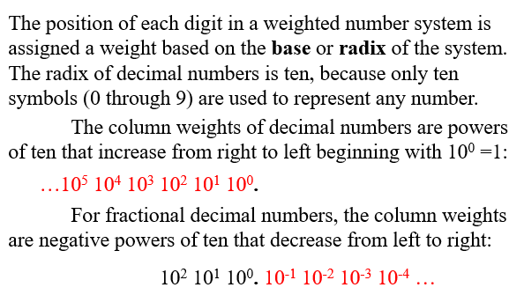
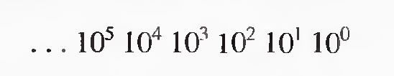
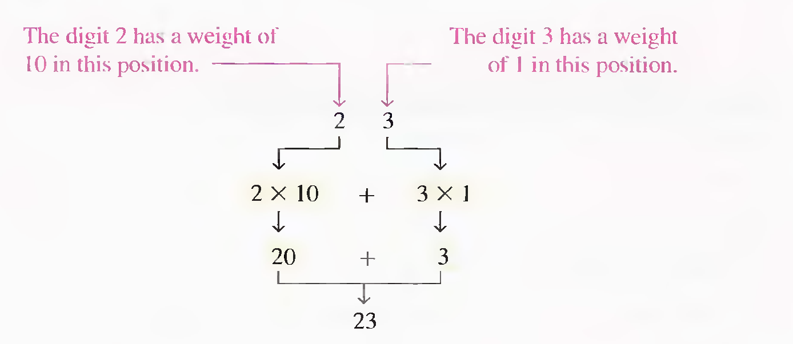
DECIMAL NUMBERS

Slide 4
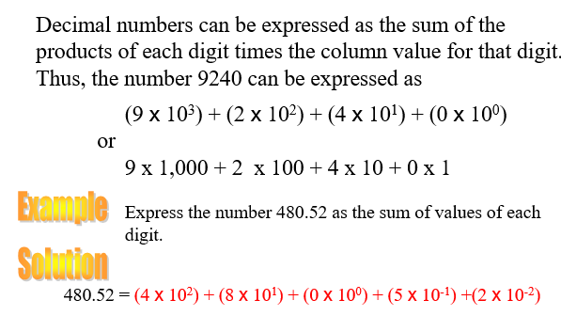

Slide 5
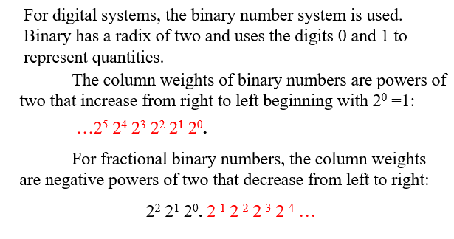
BINARY NUMBERS

Slide 6
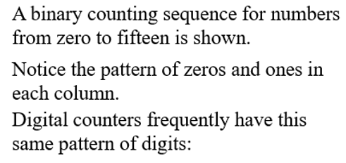
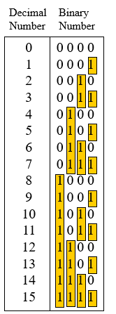




BINARY NUMBERS

Slide 7
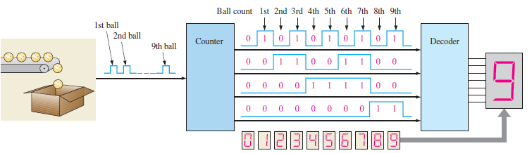
A SIMPLE BINARY COUNTING APPLICATION.

Slide 8
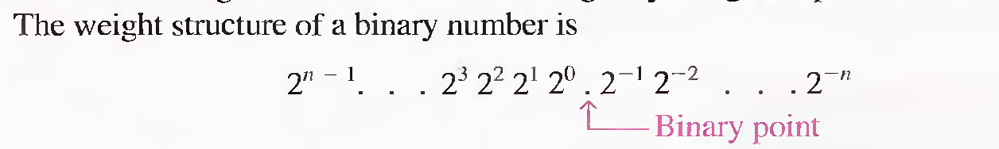
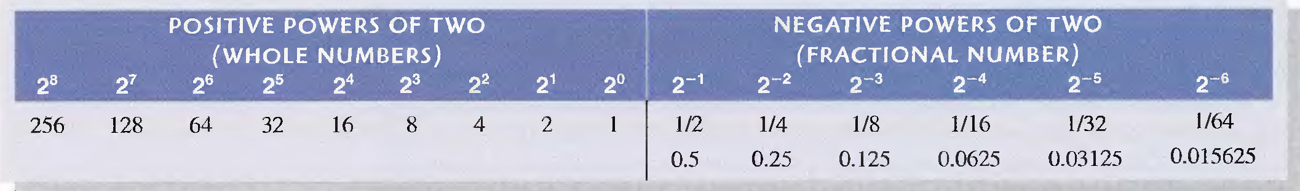

THE WEIGHTING STRUCTURE OF BINARY NUMBERS

Slide 9
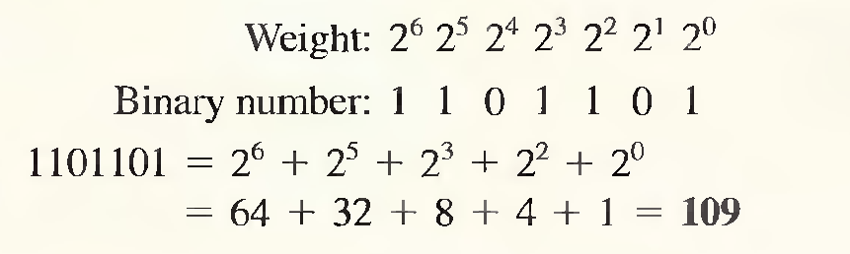
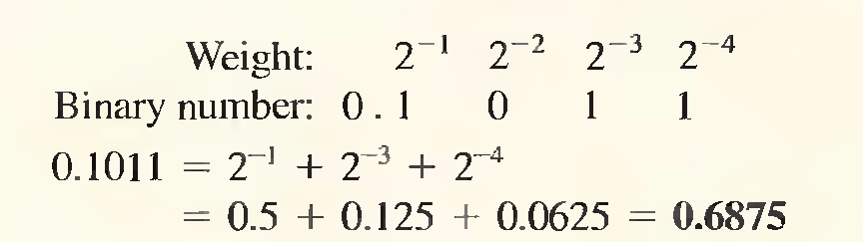

Binary to Decimal Conversion

Slide 10



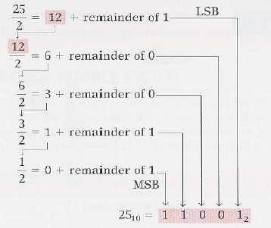
DECIMAL TO BINARY CONVERSION

Slide 11
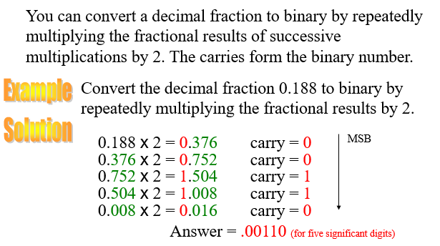
DECIMAL TO BINARY CONVERSION

Slide 12
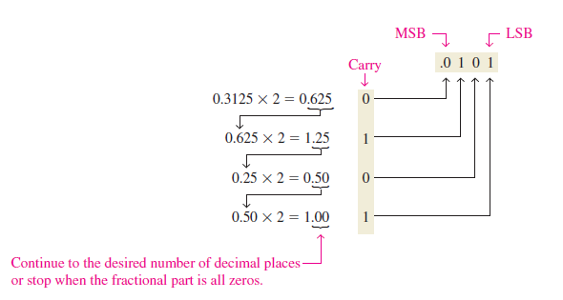
DECIMAL TO BINARY CONVERSION

Slide 13


1. 2267 2. 32768
1. 1010011 2. 1011011001 3. 20bits

Slide 14

10010001 = 145
10.111 = 2.875

Slide 15
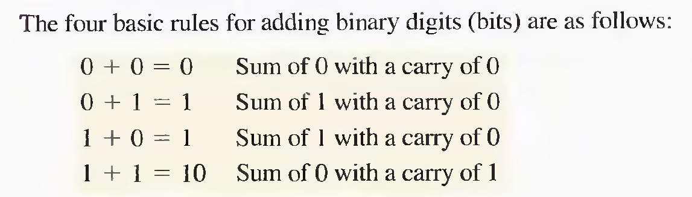
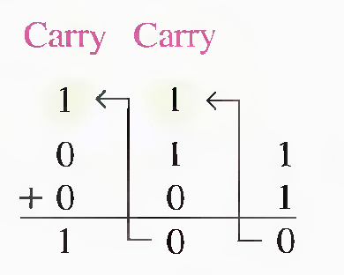
RULES OF BINARY ADDITION
11 + 11 = 110 (3+3=6)
100+ 10 = 110 (4+2=6)
111+11 = 1010 ( 7+3=10)
110+100=1010 (6+4=10)
Note: (1+1+1 = 11)

Slide 16
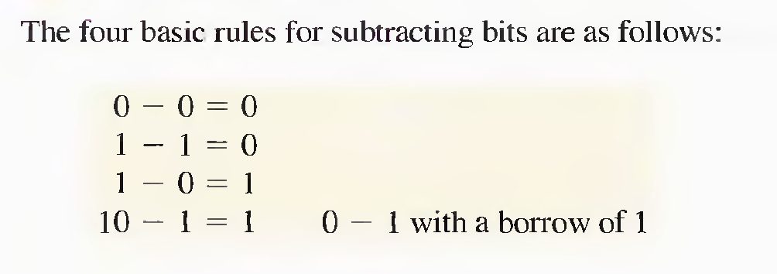
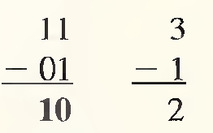
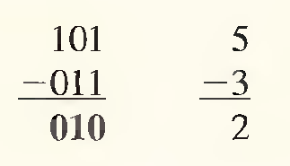
RULES OF BINARY SUBTRACTION
11-01 = 10 (3-1=2)
11-10 = 01 ( 3-2=1)
101 -011 = 010 (5-3=2)

Slide 17
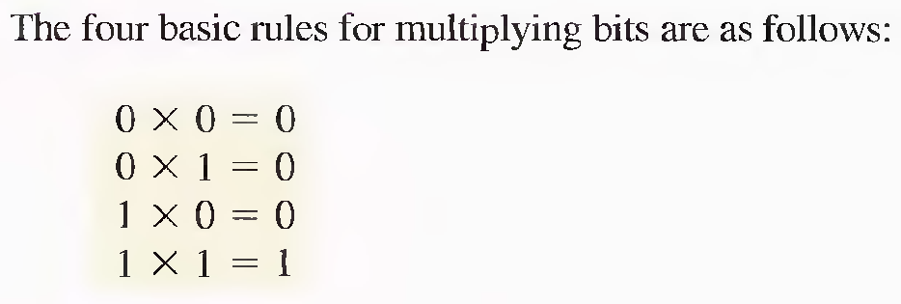
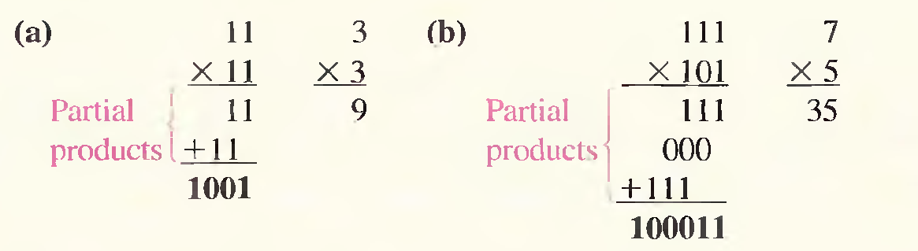
RULES OF BINARY MULTIPLICATION

Slide 18
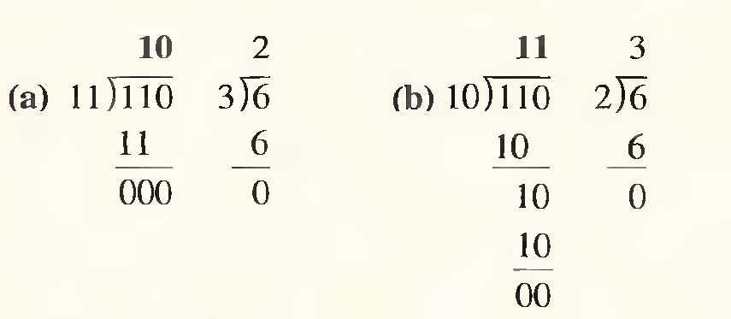
Rules of binary Division
Division in binary follows the same procedure as division in decimal. The equivalent decimal divisions are also given.

Slide 19
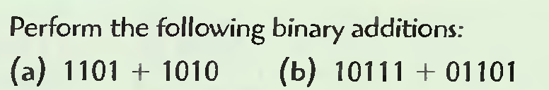
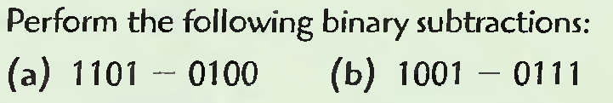
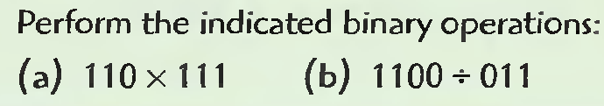
Examples

Slide 20
1’ s and 2’s Complements of Binary Numbers
Subtraction of a number from another can be accomplished by adding the complement of the subtrahend to the minuend.
Subtraction of binary numbers using the 1’s and 2’s complements method allows subtraction only by addition.

Slide 21
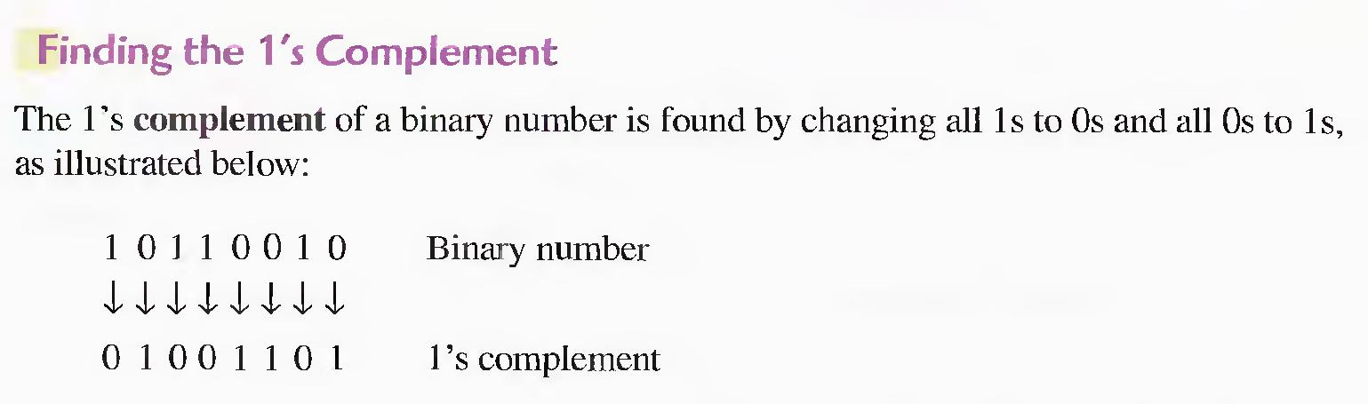
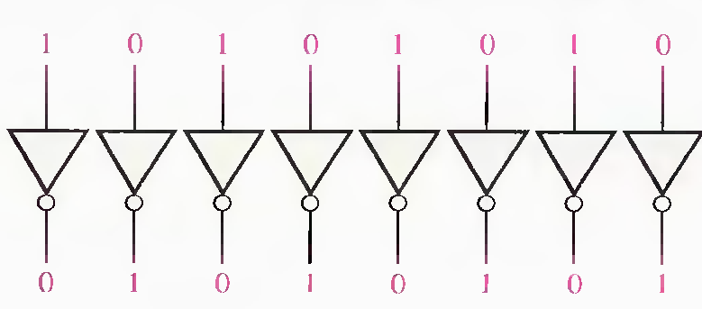
1’ s Complements of Binary Numbers

Slide 22
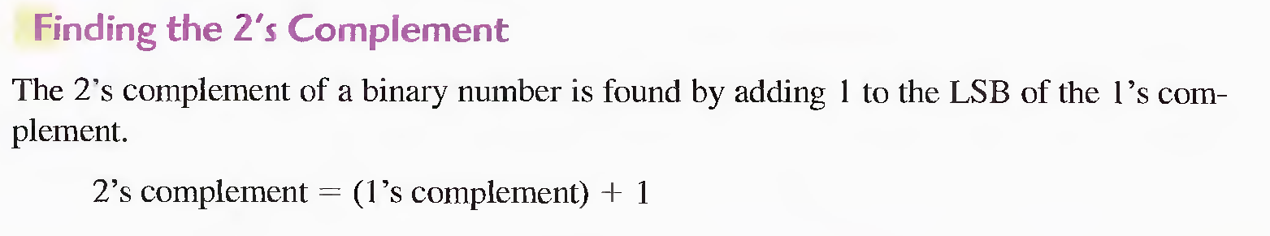
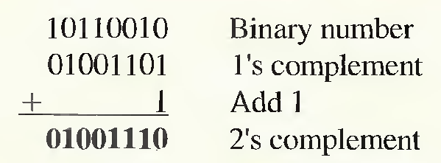
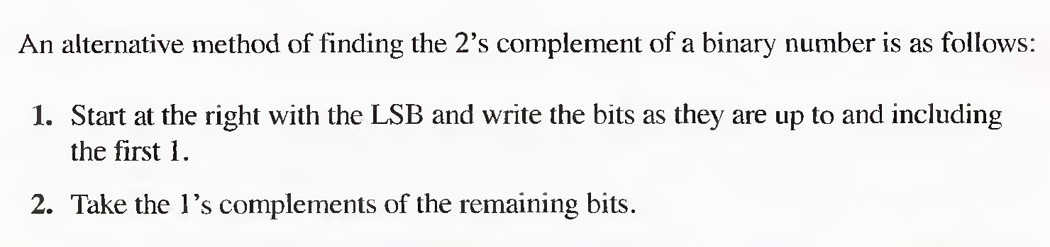
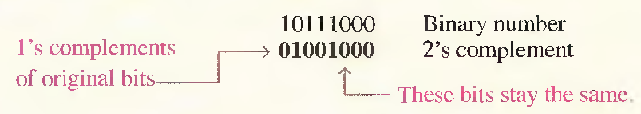
2’s Complements of Binary Numbers

Slide 23
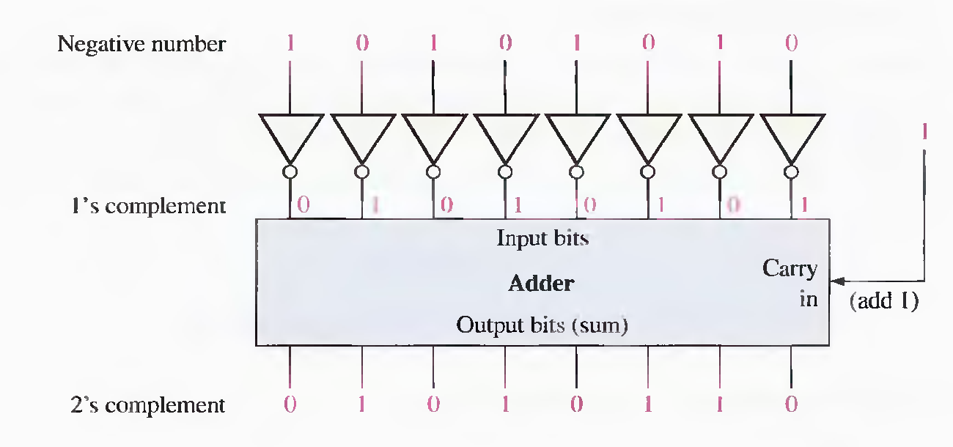
Example of obtaining the 2's complement of a negative binary number.

Slide 24
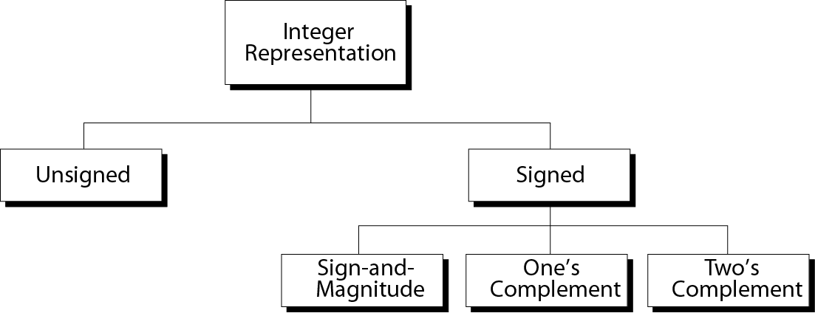
Taxonomy of integers

Slide 25
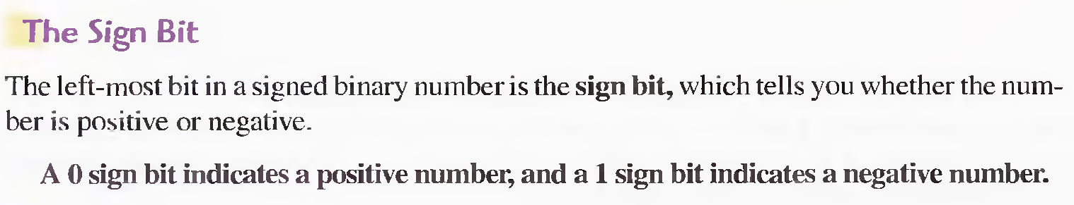
Signed Numbers
Digital systems, such as the computer, must be able to handle both positive and negative numbers. A signed binary number consists of both sign and magnitude information. The sign indicates whether a number is positive or negative, and the magnitude is the value of the number. There are three forms in which signed integer (whole) numbers can be represented in binary:
Sign-magnitude,
1's complement, and
2' complement.

Slide 26
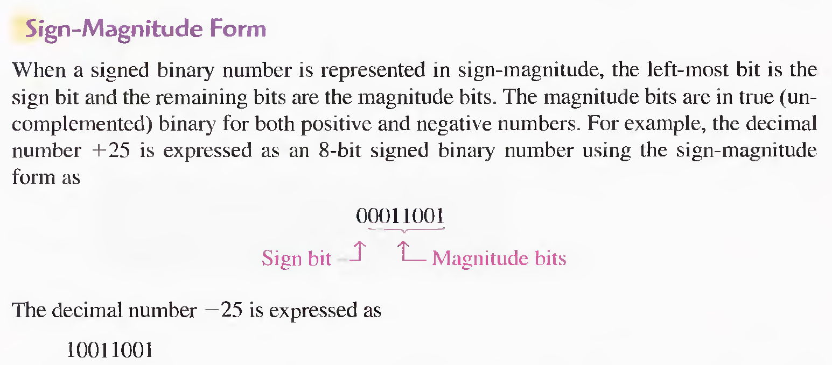
Signed Numbers

Slide 27
Signed Numbers
1’s and 2’s Complement forms
Positive numbers in I's and 2’s complement forms are represented the same way as the positive sign- magnitude numbers. Negative numbers, however, are the l's and 2’s complements of the corresponding positive numbers.
1’s Complement :
The decimal number -25 is expressed as the I' s complement of + 25 (0001100 I ) as 11100110
2’s Complement :
The decimal number -25 is expressed as the 2' s complement of + 25 (0001100 I ) as 11100111

Slide 28
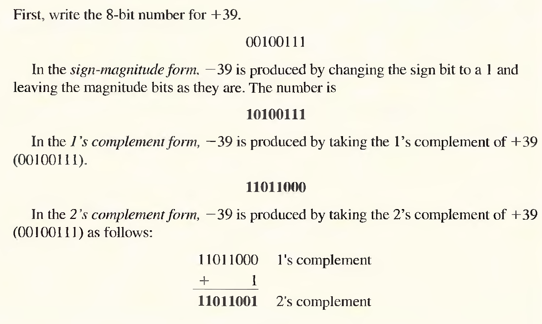
Examples (Signed Numbers)

Slide 29
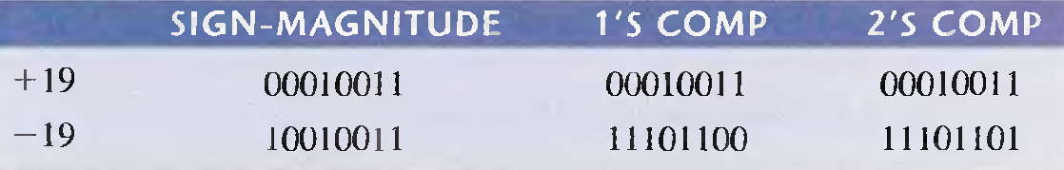
Examples (Signed Numbers)
Express + 19 and - 19 in sign-magnitude, I's complement, and 2's complement.

Slide 30
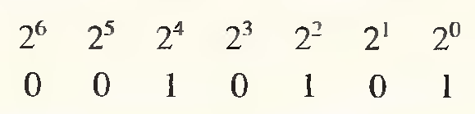

The Decimal Value of Signed Numbers
The seven magnitude bits and their powers-of-two weights are as follows:
Summing the weights where there are 1s,
The sign bit is 1; therefore, the decimal number is -21
01110111 = +119 10

Slide 31

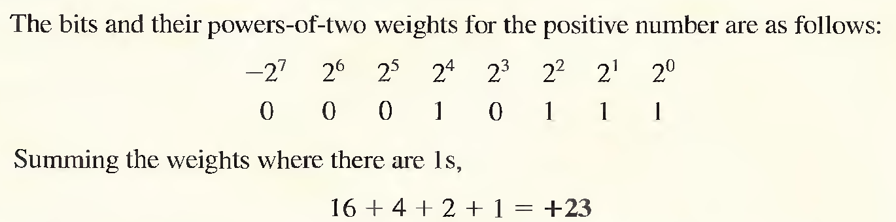
The Decimal Value of Signed Numbers
1’s Complement

Slide 32

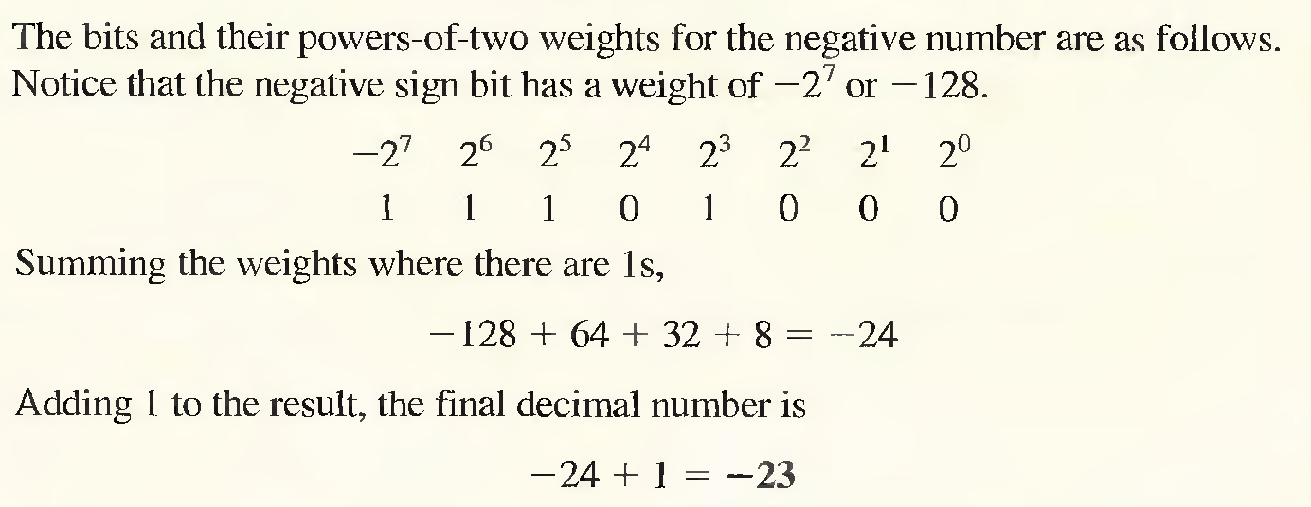
The Decimal Value of Signed Numbers
1’s Complement
-20

Slide 33
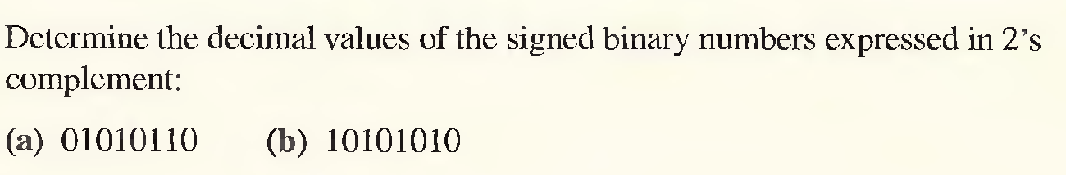
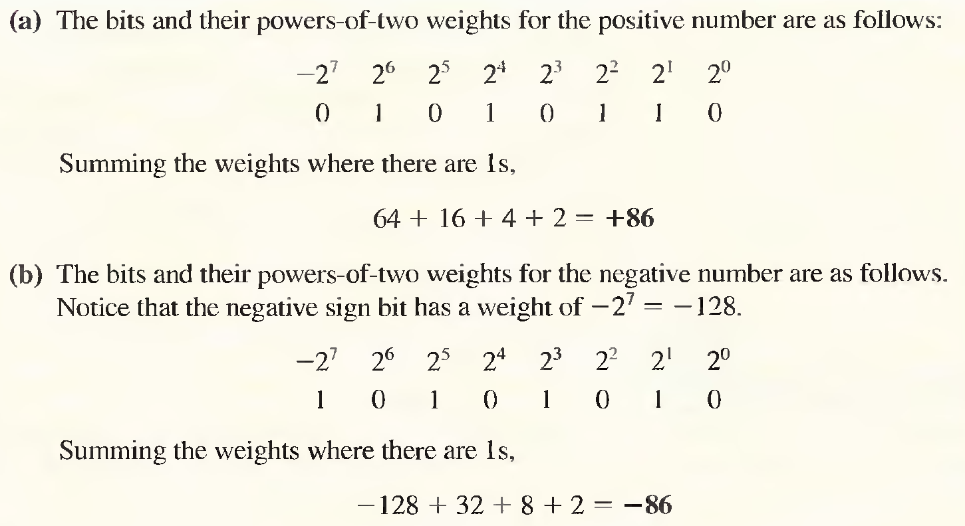
The Decimal Value of Signed Numbers
2’s Complement
-41

Slide 34
Summary of integer representation
Contents of Memory
------------
0000
0001
0010
0011
0100
0101
0110
0111
1000
1001
1010
1011
1100
1101
1110
1111
Unsigned
------------
0
1
2
3
4
5
6
7
8
9
10
11
12
13
14
15
Sign-and-Magnitude
−−−−−−−−−
+0
+1
+2
+3
+4
+5
+6
+7
−0
−1
−2
−3
−4
−5
−6
−7
One’s
Complement
−−−−−−−−−
+0
+1
+2
+3
+4
+5
+6
+7
−7
−6
−5
−4
−3
−2
−1
−0
Two’s
Complement
−−−−−−−−
+0
+1
+2
+3
+4
+5
+6
+7
−8
−7
−6
−5
−4
−3
−2
−1

Slide 35
Range of unsigned integers
# of Bits
---------
8
16
Range
-------------------------------------
0 255
0 65,535

Slide 36
Range of sign-and-magnitude integers
# of Bits
----------
8
16
32
Range
-------------------------------------------------------
−127 −0
−32767 −0
−2,147,483,647 −0
+0 +127
+0 +32767
+0 +2,147,483,647

Slide 37

Note:
There are two 0s in one’s complement
representation: positive and negative.
In an 8-bit allocation:
+0 ➔ 00000000
-0 ➔ 11111111

Slide 38
Range of two’s complement integers
# of Bits
---------
8
16
32
Range
-------------------------------------------------------
−128
−32,768
−2,147,483,648
0 +127
0 +32,767
0 +2,147,483,647

Slide 39
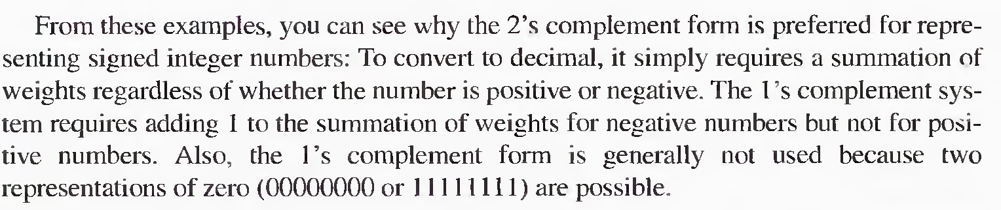
The Decimal Value of Signed Numbers
1’s and 2’s Complement

Slide 40
ADD/SUB : 4 COMBINATIONS
9
+ 5
14
(-9)
+ 5
- 4
Positive / Positive
Positive Answer
Negative / Positive
Negative Answer
9
+ (-5)
4
(-9)
+ (-5)
- 14
Positive / Negative
Positive Answer
Negative / Negative
Negative Answer

Slide 41
POSITIVE / POSITIVE COMBINATION
9
+ 5
14
00001001
+ 00000101
⎯→
⎯→
Positive / Positive
Positive Answer
←⎯
00001110
Both Positive Numbers
Use Straight Binary Addition

Slide 42
POSITIVE / NEGATIVE COMBINATION
9
+ (-5)
4
00001001
⎯→
Positive / Negative
Positive Answer
+ 11111011
←⎯
1]00000100
1-Positive / 1-Negative
Take 2’s Complement
Of Negative Number (-5)
8th Bit = 0 : Answer is Positive
Disregard 9th Bit
00000101
↓↓↓↓↓↓↓↓
11111010
+1
11111011
2’s
Complement
Process

Slide 43
NEGATIVE / POSITIVE COMBINATION
(-9)
+ 5
- 4
11110111
Positive / Negative
Negative Answer
⎯→
+ 00000101
11111100
1-Positive / 1-Negative
Take 2’s Complement
Of Negative Number (-9)
8th Bit = 1 : Answer is Negative
Take 2’s Complement to Check Answer
11111100
↓↓↓↓↓↓↓↓
00000011
+1
00000100
00001001
↓↓↓↓↓↓↓↓
11110110
+1
11110111
2’s
Complement
Process
2’s
Complement
Process

Slide 44
NEGATIVE / NEGATIVE COMBINATION
(-9)
+ (-5)
- 14
⎯→
11110111
2’s Complement
Numbers, See
Conversion Process
In Previous Slides
Negative / Negative
Negative Answer
⎯→
+ 11111011
1]11110010
2-Negative
Take 2’s Complement Of
Both Negative Numbers
8th Bit = 1 : Answer is Negative
Disregard 9th Bit
Take 2’s Complement to Check Answer
11110010
↓↓↓↓↓↓↓↓
00001101
+1
00001110
2’s
Complement
Process

Slide 45
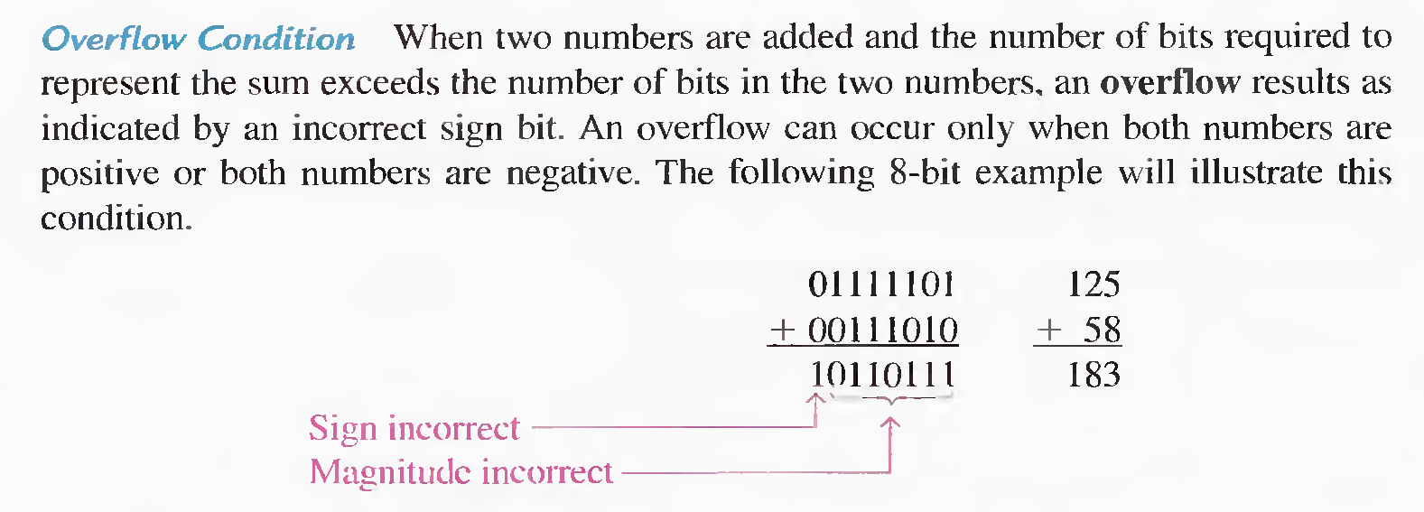
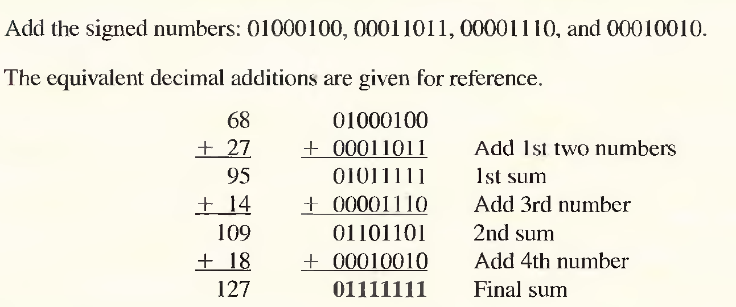

Slide 46
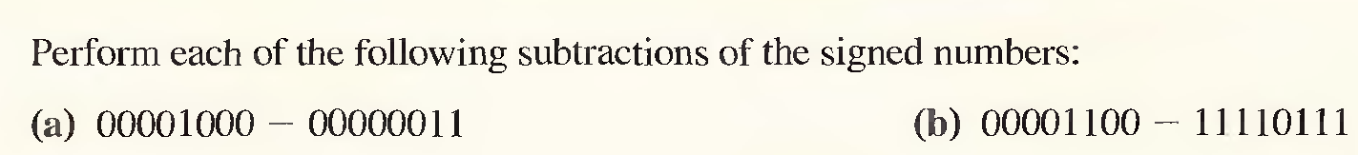
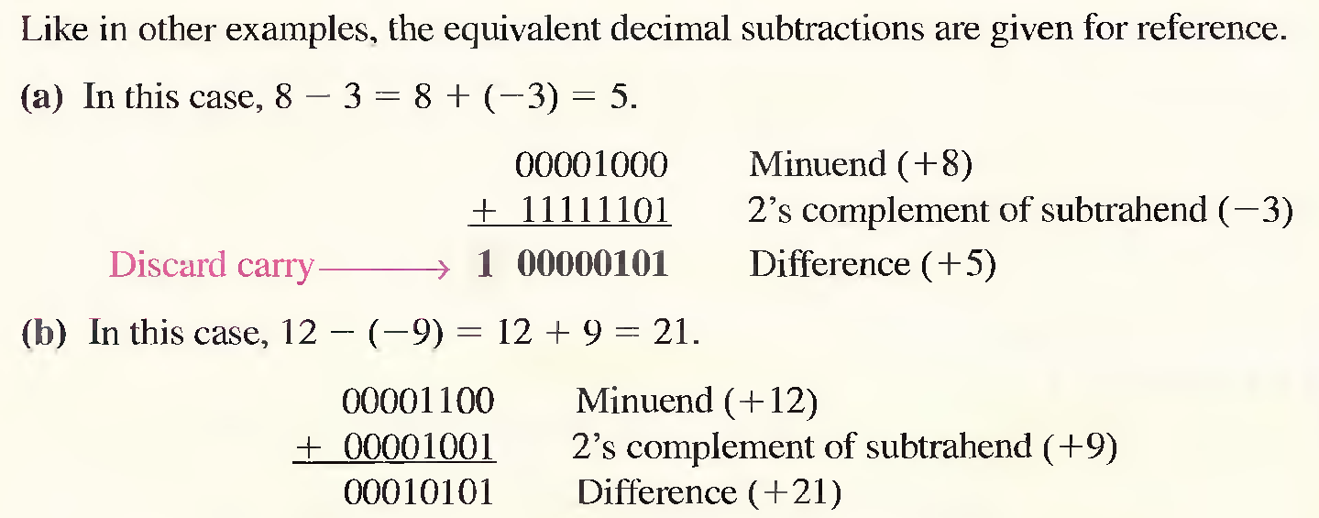
Subtraction (Examples)

Slide 47
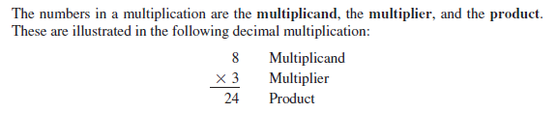
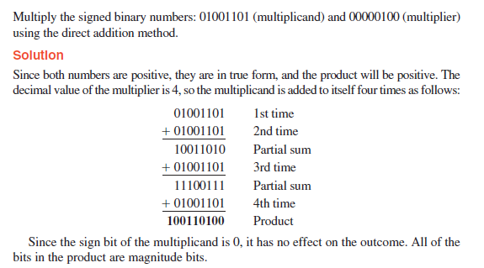
Signed Multiplication

Slide 48


Signed Multiplication

Slide 49



Signed Multiplication
The following example shows signed 2's complement representation
can be used to represent negative operands as well as positive ones
in multiplication( using 6bit representation).
Example:

Slide 50



Slide 51

Signed Division

Slide 52


Slide 53






Slide 54





Slide 55




Slide 56




Slide 57


Slide 58
USEFULNESS OF HEX
Hex is often used in a digital system as sort of a “Shorthand” way to represent string of bits.
When dealing with the large numbers of bits , it is more convenient and less error to write the binary in hex.
Would you rather check 50 numbers like this one 0110111001100111
or 50 numbers like this one 6E67 ?
Digital circuit work in binary.
Hex is simply used as a convenience for the humans involved.

Slide 59



Slide 60


Slide 61

Code:
When the numbers , letters or word are represented by a special group of symbols, we say they are being encoded, and the group of symbols is called a Code.
Straight binary Code:
When a decimal number is represented by its equivalent binary number, called Straight binary Code.
BCD Code:
If each digit of a decimal number is represented by its binary equivalent, the result is a code called Binary –Coded –Decimal (BCD)
Since a decimal digit can be as large as 9, four bits are required to code each digit .

Slide 62



BINARY CODED DECIMAL
If any of the “forbidden” four bit numbers ever occurs in a
machine using the BCD code, it is usually an indication that an error has occurred.

Slide 63

COMPARISON OF BCD AND BINARY
BCD is not another number system like binary , octal and hexadecimal .
It is the decimal system with each digit encoded in its binary equivalent.
Advantage:
Easy conversion
Disadvantage:
BCD required more bits
Example: Decimal Binary BCD
11 1011 0001 0001

Slide 64

ADDITION OF BCD NUMBERS

Slide 65

NOTE THAT IN EACH CASE THE SUM IN ANY 4 BIT COLUMN DOES NOT EXCEED 9, AND THE RESULT ARE INVALID BCD NUMBERS.
Addition of BCD numbers

Slide 66

Addition of BCD numbers

Slide 67


Addition of BCD numbers

Slide 68
GRAY CODE:
The bits in a binary count sequence, it is clear that there are often several bits that must change states at the same time. Consider when 3 - bit binary number for 3 change to 4 : all three bits must change state.
011 ( decimal 3 )
100 ( decimal 4 )
In order to reduce the likelihood of a digital circuit misinterpreting a changing input , the Gray code has been developed as way to represent a sequence of numbers.
The unique aspect of the Gray code is that only one bit ever changes between two successive numbers in sequence.
The Gray code is also known as The Reflected Code

Slide 69

THREE BIT BINARY AND GRAY CODE EQUIVALENTS

Slide 70

AN APPLICATION
THE CONCEPT OF A 3-BIT SHAFT

Slide 71
BINARY TO GRAY CODE CONVERSION
MSB Binary use as Gray MSB
Compare MSB Binary with next binary bit (B1)
If they are same G1 = 0
If they are different G1 = 1
G0 can be found by comparing B1 and B0

Slide 72

CONVERTING BINARY TO GRAY CODE

Slide 73
GRAY CODE TO BINARY CONVERSION
Gray MSB used as MSB binary
Compare Gray MSB with binary bit (G1)
If they are same B1 = 0
If they are different B1 = 1
B0 can be found by comparing B1 and G0

Slide 74

CONVERTING GRAY TO BINARY CODE

Slide 75

PUTTING ALL TOGETHER

Slide 76
THE BYTE , NIBBLE AND WORD
The Byte :
A string of eight bits is called a Byte .
The Nibble :
A group of four bit( Half of a byte) is called a Nibble.
The Word :
A word is a group of bits that represent s a certain unit of information

Slide 77
ALPHANUMERIC CODES:
The codes that represent letters of the alphabet , punctuation marks, and other special characters as well as numbers are called Alphanumeric Codes.
26 lowercase letter
26 uppercase letter
10 numeric digits
7 punctuation marks
20 to 40 other characters such as + , / , %, * and so on

Slide 78
AMERICAN STANDARD CODE FOR INFORMATION INTERCHANGE( ASCII )CODE:
ASCII is widely used alphanumeric code.
ASCII is a seven –bits code (2⁷ =128 possible code group)
ASCII code for each character can be obtain by converting the hex value to binary.
Character ACSII code Hex Decimal
A 100 0001 41 65
B 100 0010 42 66
0 011 0000 30 48

Slide 79


AMERICAN STANDARD CODE FOR INFORMATION INTERCHANGE ( ASCII )CODE:
The ASCII code is used for the transfer of alphanumeric information between a computer and external devices such as printer or another computer.
Example :
The binary string that will be entered into memory when the operator types
if (x >3).

Slide 80

ERROR DETECTION CODES
Examples of the movement of binary data and code :
The transmission of digital voice over a microwave link.
The storage of data in and retrieval of data from external memory devices.
Sending and receiving information on the Internet.
Whenever information transmitted errors can occur such that receiver does not receive the identical information that was sent by transmitter. The major cause of transmission error is electric noise ( fluctuation of current and voltage)
An error detection code can be used to detect error during transmission.
Most modern digital equipment is designed to be relatively error free and the probability of error is very low

Slide 81
PARITY METHOD FOR ERROR DETECTION
One of the simplest and most widely used schemes for error detection is the Parity Method
Parity Bit:
A parity bit is an extra bit that is attached to a code group that is being transferred from one location to another. It is made either 0 or 1.
There are two parity methods:
Even Parity method
Odd Parity method

Slide 82


EVEN PARITY METHOD :
If number of 1s in the code group odd then add a parity bit of 1 .
For example:
If number of 1s in the code group even then add a parity bit of 0 .
For example:

Slide 83


ODD PARITY METHOD :
If number of 1s in the code group even then add a parity bit of 1 .
For example:
If number of 1s in the code group odd then add a parity bit of 0 .
For example:

Slide 84


Suppose that the character A is being transmitted and odd parity is being used .
The transmission code would be
The receiver will check that the code contain an odd number of 1s (including the parity)
If so, receiver assume that the code has been correctly receive.
Supposed Some noise change code as
The receiver will find that this code has an even number of 1s and error is detected.
There is no way that the receiver can tell which bit is in error because it does not know what the code is supposed to be .
The parity method would not work of two bits were in error .

Slide 85


